Slide 1
202: Lesbian, Gay, Bisexual, Transgender and Questioning Youth in the Child Welfare System

Slide 2
Agenda
Welcome and Introductions
Myths vs. Facts
Four Areas of Support
Definitions
Homophobia and Heterosexism
Assessing Needs
Strategies
Closing and Evaluations

Slide 3
Learning Objectives (1 of 2)
Recognize the prevalence of LGBTQ youth and knowledge of the issues and health disparities facing these youth
Describe the differences between gender identity, gender role, sexual orientation and sexual behavior, and will be able to correctly use these and other sexual minority terms
Define and cite examples of homophobia and heterosexism and understand the impact that these issues have on LGBTQ youth

Slide 4
Learning Objectives (2 of 2)
Describe the needs of sexual minority youth and how to address these needs
Develop intervention strategies for responding to the issues that arise in child welfare placement settings with LGBTQ youth

Slide 5
Beliefs and Sources of Information

Slide 6
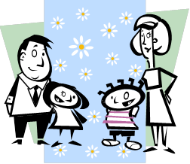
Four Areas of Support (1 of 4)
FAMILY
Many LGBTQ youth are rejected by their families
Many are forced to leave home
Many are subjected to violence
Cannot rely on family for support in tough times

Slide 7
Four Areas of Support (2 of 4)
II. SCHOOL
Hostile school environment
Verbal and Physical Assaults
Many drop out of school
Creates difficulty in authentic peer interactions

Slide 8
Four Areas of Support (3 of 4)
III. COMMUNITY
Very few programs exist for LGBTQ youth
Many community organizations have strong anti-gay views
Many activities in LGBTQ community are adult-oriented

Slide 9
Four Areas of Support (4 of 4)
RELIGIOUS PARTICIPATION
Majority of churches and other groups reject homosexuality
Many youth feel compelled to choose between religion and self
Many organizations believe that it is something to be “cured”

Slide 10
Homophobia
A Feeling Behavior that is characterized by fear, prejudice, and even hatred against lesbian, gay, bisexual, transgender and questioning persons. Homophobia can often be what is at the root of violence, harassment, and hate crimes committed against LGBTQ persons.

Slide 11
Heterosexism
The Total Behavior characterized by a chauvinistic attitude which maintains that normal persons are heterosexual and any persons other than heterosexual are thought to be sick, flawed, diseased, dysfunctional, perverted. In this scenario, being heterosexual is the only acceptable way to be, and society at large sends that message in many arenas.

Slide 12
Homophobic Levels of Attitude: Negative (1 of 4)
REPULSION: Being a gay person is seen as sick, immoral, perverted, and against nature. Anything at all that may change them or fix them is seen as justified, including prison, hospital, even electric shock therapy.

Slide 13
Homophobic Levels of Attitude: Negative (2 of 4)
PITY: This level of attitude is heterosexist in nature. It stems from the belief that being heterosexual is the best way to be. If they cannot be converted to a heterosexual, then they must be born that way and should be pitied.

Slide 14
Homophobic Levels of Attitude: Negative (3 of 4)
TOLERANCE: This is just a phase as a teen, and most teens will just grow out of it. Therefore, gay persons will probably be less mature than heterosexual persons will be. Gay persons should not hold important positions, because they still need to grow up.

Slide 15
Homophobic Levels of Attitude: Negative (4 of 4)
ACCEPTANCE: The implication is that there is something still to accept, and heterosexual persons do not want to talk or think about the fact that you are gay; you are just a person to them. I am okay with you being a gay person as long as you do not flaunt it all the time.

Slide 16
Homophobic Levels of Attitude: Positive (1 of 4)
SUPPORT: Persons are working to help preserve the rights of gay and lesbian persons. Even though persons in this group may be uncomfortable about the issue, they do agree that as a group, gay persons are treated unfairly.

Slide 17
Homophobic Levels of Attitude: Positive (2 of 4)
ADMIRATION: Persons believe that it takes a great deal of strength to be a gay person in society. Persons at this level are willing to look at their own homophobic attitudes and work on them.

Slide 18
Homophobic Levels of Attitude: Positive (3 of 4)
APPRECIATION: These persons value the diversity of others and see gay persons as part of that diversity. These persons are willing to challenge their own homophobic attitudes and those of others.

Slide 19
Homophobic Levels of Attitude: Positive (4 of 4)
NURTURANCE: Persons at this level of attitude believe that gay persons are a necessary aspect of our society. They have positive feelings toward gay persons, and advocate on behalf of gay persons when it is needed.

Slide 20
An Experience With Being Different
Think of an LGBTQ youth, either one you had or currently
have on your caseload. Name an experience
when that youth felt very different from others.
Try to assume that youth’s total behavior.
(What was the youth doing, thinking, experiencing emotionally, and experiencing physically during the experience?)
Has the youth chosen any different aspects of behavior
since having that experience?

Slide 21
Developmental Models: Troiden’s Model
Sensitization - Adolescent feels different from others; may exhibit some cross-gender behaviors; tries to hide differences from others.
Identity Confusion - Typically occurs in late adolescence; try to hide feelings one has for same gender; dates persons of other gender as a way to pass; denial, avoidance, and tries to repair oneself.
Identity Assumption - Seeking connections with others in the gay community or identify themselves as gay.
Commitment - Sexual orientation is integrated into the larger sense of self; begin to establish relationships with other gay persons.

Slide 22
Developmental Models: Cass’ Model
Identity Confusion - Not sure if gay or not, a growing awareness of being different.
Identity Comparison - Gathering information and establishing contact with persons who are gay.
Identity Tolerance - Probably am gay, but I am not sure that I want to be.
Identity Acceptance - Begin to feel validated; experiences conflict with heterosexist attitudes.
Identity Pride - Pride in one’s sexual orientation, begins to experience a sense of belonging.
Identity Synthesis - One’s sexual orientation becomes integrated in with other parts of one’s personality.

Slide 23
As Told by LGBTQ Youth
“I thought I was destined to a life of perversity, sickness, loneliness, and eternal damnation. I can still remember the pain that made me want to die.”
“It was the love of a totally accepting grandmother that helped teach me I was okay.”
“On TV it was always male/female. But being straight, doing what everyone else was doing; didn’t seem natural. That wasn’t what felt healthy for me.”
“Earlier, I could push off the emotions and say, ‘He’s just a good friend.’ But in sixth grade, I remember being sexually attracted to boys in my class…you can’t deny the sexual attractions.”
“I always was gay, but I did everything possible to prove I was heterosexual. That was painful for everyone.”
“I went through hell because there was no one for me to talk to. I had these feelings, and I couldn’t explain them…but they hurt, and I needed someone to talk to. I never got that, and I needed it.”

Slide 24
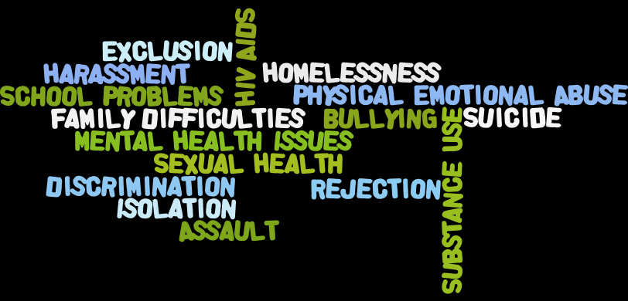
Risk Factors
Some of the many risk factors for LGBTQ youth include:

Slide 25
Strategies
Identify strategies to support LGBTQ youth:
Personally
Individually
Professionally
As a group or agency

Slide 26
Standup Quote
“In Germany they first came for the Communists and I didn’t speak up because I wasn’t a Communist. Then they came for the Jews, and I didn’t speak up because I wasn’t a Jew. Then they came for the trade Unionists, and I didn’t speak up because I wasn’t a trade unionist. Then they came for the Catholics, and I didn’t speak up because I was a Protestant. Then they came for me - and by that time no one was left to speak up.”
--Pastor Martin Niemöller

Slide 27
Conclusions and Evaluations
References: http://www.pacwrc.pitt.edu/Curriculum/ under 202: LGBTQ Youth in the Child Welfare System Handout #7 (References)
LGBTQ Resource Manual: http://www.pacwrc.pitt.edu/Curriculum/ under 202: LGBTQ Youth in the Child Welfare System, Appendices, Appendix #1
Toolkit to Support Child Welfare Agencies in Serving LGBTQ Youth, Children, and Families http://www.pacwrc.pitt.edu/Curriculum/ under 202: LGBTQ Youth in the Child Welfare System, Appendices Appendix #5

